Slide 1

Building an end-to-end machine learning workflow using
Model Inception to Deployment
Vivek Katial
Data Scientist
Notes:
Hi everyone,
I am Vivek Katial, and I will be talking to all of you today on how to build an end-to-end machine learning workflow using mlflow ! I will attempt to take you guys through from model inception to model deployment.
Quantiful has been using mlflow almost since it launched last year and I am really excited to present to you all today.

Slide 2
About me
Data Scientist using buzzword technologies @ Quantiful
Student -> Data Analyst -> Data Scientist
Other Interests
Cricket
Travel
Food and Beverages
Notes:
Now quickly for some background on me. Right now, I spend my time in the product development team at Quantiful. Quantiful is building an analytics platform to predict demand for consumer goods and my job is desigining and implementing the underlying analytics engine. We are up on K Road in a snazzy office and feel free to ask me questions about the work we do there after the talk.
Anyway I studied Engineering Science and Statistics at the University of Auckland then have been working at Quantiful since. Some other interests I have are Cricket, travelling, being a foodie and “beverages”.

Slide 3
Outline
Motivation and background of MLflow
The design thinking behind MLflow
MLflow components
Live Demo! (risky)
Questions & Answers
Notes:
Cool, enough about me. Now the structure of this talk is inspired from Matei Zaharia’s keynote from the 2018 Spark AI Summit. Matei developed the mlflow project, along with Apache Spark, Mesos and wrote the scheduler in Apache Hadoop so yea, he’s a pretty incredible guy.
First we will start off with a motivation for why MLFlow was developed and what it is.
I’ll then discuss the design philosophy around how mlflow was designed.
Mlflow has 3 components which we will dive deeper into
Then we will finally end with a live demo using the Mlflow R API (hopefully this works)
Finally we can do some Q&A where you guys can ask some questions and hopefully I can answer them :P
Ok who here has been or currently involved in Machine Learning development?

Slide 4
Machine Learning Development is HARD
Notes:
Well we all know that machine learning development is complex. Because other than the usual concerns and complexities of software development, ML development has its own challenges, many of which at Quantiful I have had to deal with myself.

Slide 5
Motivation & Background
Prepare Data
Train Model
Deployment
Store Data
Tuning
Scale
Scale
Tuning
Scale
Scale
Reference: MLflow: Infrastructure for the Complete ML Lifecycle Matei Zaharia (Databricks)
Notes:
To break that down, everyone is familiar with this typical ML flow diagram.
First of you start off with your data which is stored in some storage facility. Now depending on your stack, scale, clients or organisation your datasets may be stored in a variety of storage platforms and in different formats ranging from AWS S3, to a kafka stream and for simple research projects maybe just csv files
Now once you’ve ingested and stored your data, there are many tools with which you can prepare your data, every data company must be very familiar with R vs Python debate.
Also in ML development, an extra challenge we face is from the “no-free-lunch theorem”- essentially there is no one best model for all your problems. As such you want to try out different tools too see which best suit your specific problem. For example, you might want to try an XGBoost model and then after some experimentation a few weeks later that you actually want to implement something from tensorflow.
Once we have a model there are also many ways to put things in production with different deployment technologies.
So the major challenge you can probably guess here is that there is a massive toolkit, that each person in the machine learning development cycle will want to play with and experiment with.
The next major challenge, is many of these steps require tuning. For example we might want to try different features in our design matrix, tune our parameters for a specific model or test our old experiments on new data. A huge challenge we face here is that we want to track our results in a meaningful way. At Quantiful for example we run 100s or 1000s of experiments every day and we need to be able to see what parameters, what model, what features were tested in each one.
This leads into the challenge of reproducibility. Without detailed tracking, teams often have trouble getting the same code to work again. Whether you are a data scientist passing your training code to an engineer for use in production, or you are going back to your past work to debug a problem, reproducing steps of the ML workflow is critical.
Especially considering each experiment can take hours to days to train, tracking results can prove to be very challenging.
The next problem is scale: A lot of problems generate A LOT of data. Often storage formats will change, or you want to prepare large amounts of data, each experiment also generates lots of data. As such this makes deploying and exchanging models challenging.

Slide 6
What is out there?
There are tools at big tech companies like Google TFX, FBLearner
Notes:
Now you’re probably wondering that this is such a common problem that there should be something to manage this. Now big tech companies

Slide 7
What if I work at Quantiful and don’t have access to these large tools?

Slide 8
Introducing
Reference: MLflow: Infrastructure for the Complete ML Lifecycle Matei Zaharia (Databricks)
Notes:
MLflow is inspired by existing ML platforms, but it is designed to be open in two senses:
Open interface: MLflow is designed to work with any ML library, algorithm, deployment tool or language. It’s built around REST APIs and simple data formats (e.g., a model can be viewed as a lambda function) that can be used from a variety of tools, instead of only providing a small set of built-in functionality.
Open Source
MLflow Tracking is an API and UI for logging parameters, code versions, metrics and output files when running your machine learning code to later visualize them. With a few simple lines of code, you can track parameters, metrics, and artifacts:
MLflow Projects provide a standard format for packaging reusable data science code. Each project is simply a directory with code or a Git repository, and uses a descriptor file to specify its dependencies and how to run the code. A MLflow Project is defined by a simple YAML file called MLproject. Projects can specify their dependencies through a Conda environment. A project may also have multiple entry points for invoking runs, with named parameters. You can run projects using the mlflow run command-line tool, either from local files or from a Git repository.
MlFlow models
Coupled with MLflow Tracking, MLflow Projects provides great tools for reproducibility, extensibility, and experimentation.
The final aspect of Mlflow is models. Models provides a convention for packaging machine learning models from different formats called flavours into one tool.

Slide 9
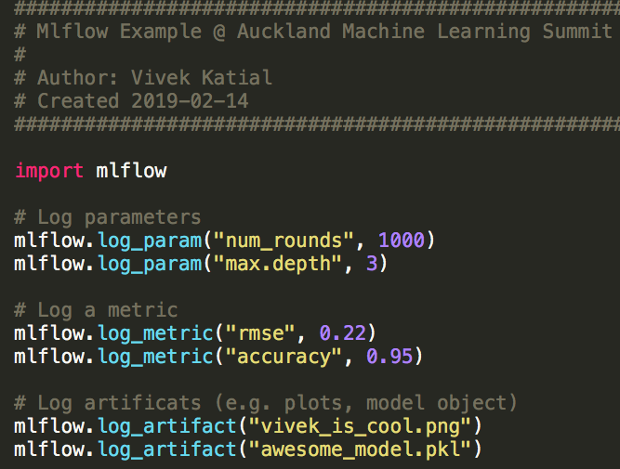
Tracking
Mlflow Tracking allows us to record experimental results, outputs and artifacts
Query results through a simple REST API
Visualise in a UI

Slide 10
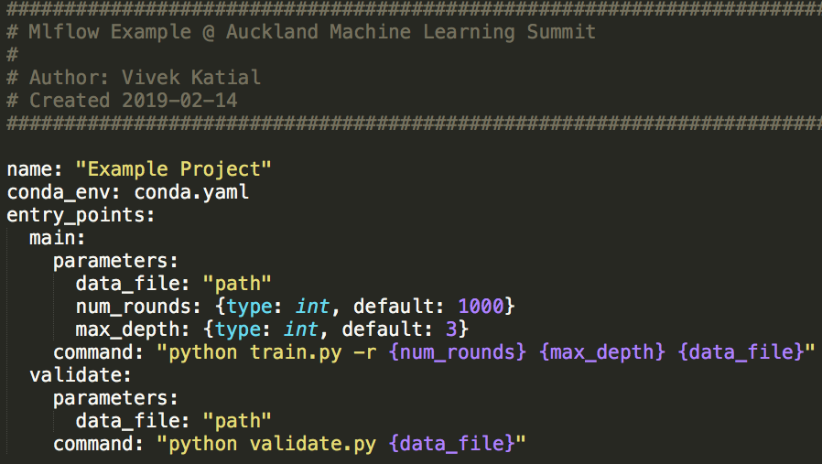
Projects
Packing format for reproducible experiments
Each project is a directory with code or a Git repository
Define dependencies for reproducibility through conda
Execution API to run local or remote projects
Notes:
MLFlow projects provides a packaging format to make reproducible experiments. Essentially a project is simply a GIT repo with all the code in it to run the project and a descriptor MLProject YAML file (we have an example here)
We define our dependencies through a conda.yaml file
And then the execution API we can also reproduce and re-run experiments!

Slide 11
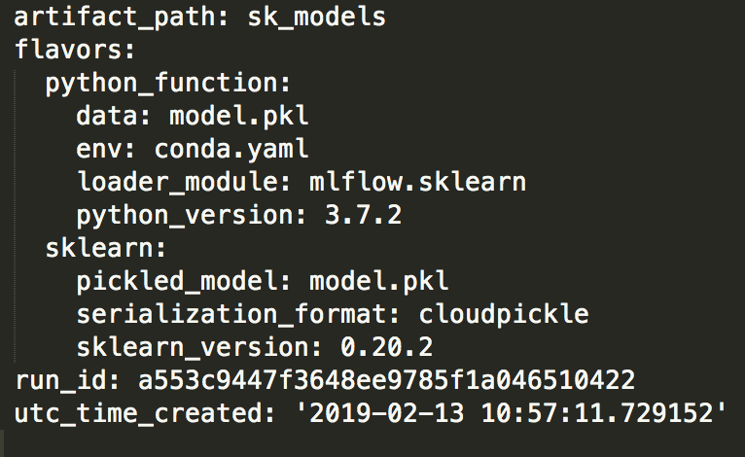
Models
Packing format for ML models
Define dependencies for reproducibility through MLProject
Deployment API to make results easily viewable anywhere
Notes:
ML models is the final component. One which we have had limited use with at Quantiful. However, it provides a packaging format for ML models. The convention developed defines dependencies to allow for reproducibility through our MLProject file in the base directory and its also accompanied with a deployment API which makes results viewable anywhere very quickly.
An MLflow Model is a standard format for packaging machine learning models that can be used in a variety of downstream tools—for example, real-time serving through a REST API or batch inference on Apache Spark. The format defines a convention that lets you save a model in different “flavors” that can be understood by different downstream tools.

Slide 12
Live Demo!

Slide 13
Questions and Answers

